Slide 1
Wabash Capstone
Project Notes 03
By: John Danison

Slide 2
What Did I Say I Would Do This Week?
Continue to refine the noise readings in strain gauge.
Continue creating schematics in Altium Designer

Slide 3
What I Have Done Over The Past Week
Added additional software filtering in firmware to help reduce noise.
Scheduled and held a meeting with my analog signal processing professor Mike Jacob.
Started constructing new noise conditioning circuit.
Attended the Wabash Coupler manufacturing tour. Ensured standard wire terminations match planned PCB implication.

Slide 4
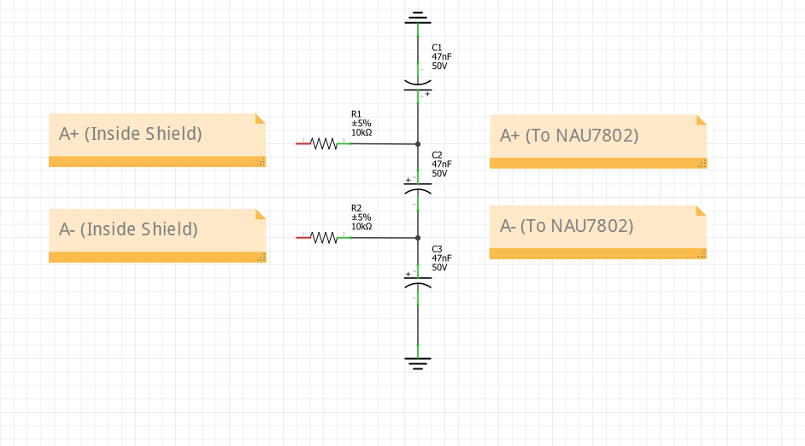
Nosie Reduction Strategies
Professor Jacob described a method to help significantly reduce the noise.
Instead of using the breadboard jumper wires, use shielded twisted pair wires such as a microphone cable.
Then attach the circuit configuration to the right DIRECTLY before the terminal.
He also offered his further assistance Fridays from 11:30 – 2:30 in which I will use this upcoming week.

Slide 5
Did I Do What I Say I Would Do?
I took the initiative to schedule a meeting to get help with noise filtering, I began testing this. I didn’t get around to doing any Altium drawings this week as a result.
I showed up to every lecture, lab, and meeting and contributed my knowledge with everyone.

Slide 6
Plans For Upcoming Weeks
High Level
By EOW:
Continue to refine system sensors & configuration.
Continue to learn how to use Altium Designer.
Continue to show up to class.
Continue to further refine the noise readings in strain gauge circuit.
Continue creating schematics in Altium Designer if time allows.

